Slide 1
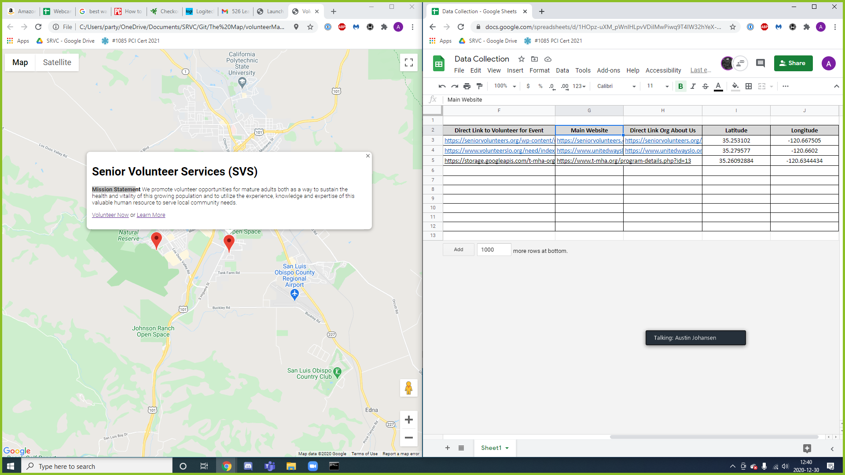
[Volunteer Event Title]
[Volunteer Event Description]
Remove “ or Learn More”
Organized By [Org Name] (link to org main website)

